Slide 1
TITUS

Slide 2
TITUS

Slide 3
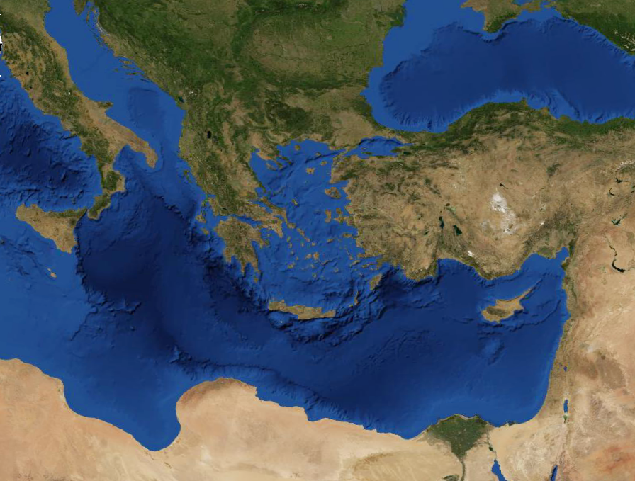
TITUS
Dalmatia
Macedonia
Corinth
Ephesus
Crete
Jerusalem

Slide 4
TITUS
3. Met Paul in Macedonia
5. Ministering in Dalmatia
AD 45
AD 50
AD 55
AD 60
AD 65
AD 70
1. Attended Jersusalem Council
4. Pastors church on Crete
2. Sent to Corinth to received offering
1st Missionary Journey
Journey to Rome
2nd Missionary Journey
1st Imprisonment
3rd Missionary Journey
2nd Imprisonment

Slide 5
TITUS
Sound doctrine
1:9, 13, 2:1, 2:2, 2:7, 2:8, 2:10
Good works
1:16, 2:3, 2:7, 2:10, 2:14,
3:8, 3:14

Slide 6
TITUS
Elder ~ presbuteros
Bishop ~ episkopos
Presbuteros refers to the man
Episkopos refers to the office

Slide 7
TITUS
Sound ~ hugiainō – cognate of hygiene

Slide 8
TITUS
Homemakers ~ oikos (home) + ouros (guard)

Slide 9
TITUS
PRESENT
FUTURE
PAST
Eph. 2:8
1 Cor. 13:12
1 Cor. 1:18
Justification
Glorification
Sanctification

Slide 10
TITUS
as His divine power has given to us all things that pertain to life and godliness, through the knowledge of Him who
called us by glory and
virtue,
2 Peter 1.3

Slide 11
TITUS
⁶ knowing this, that our old man was crucified with Him, that the body of sin might be done away with, that we should no
longer be slaves of sin. ⁷
For he who has died has
been freed from sin.
Romans 6.6-7

Slide 12
TITUS
For He made Him who knew no sin to be sin for us, that we might become the righteousness of God in Him.
2 Corinthians 5.21

Slide 13
TITUS

